Slide 1

Uncharted Territories: Discovering Vulnerabilities in Public Helm Charts
KubeCon/Cloud Native Con Europe 2020
Hayley Denbraver

Slide 2

Ahoy!

Slide 3
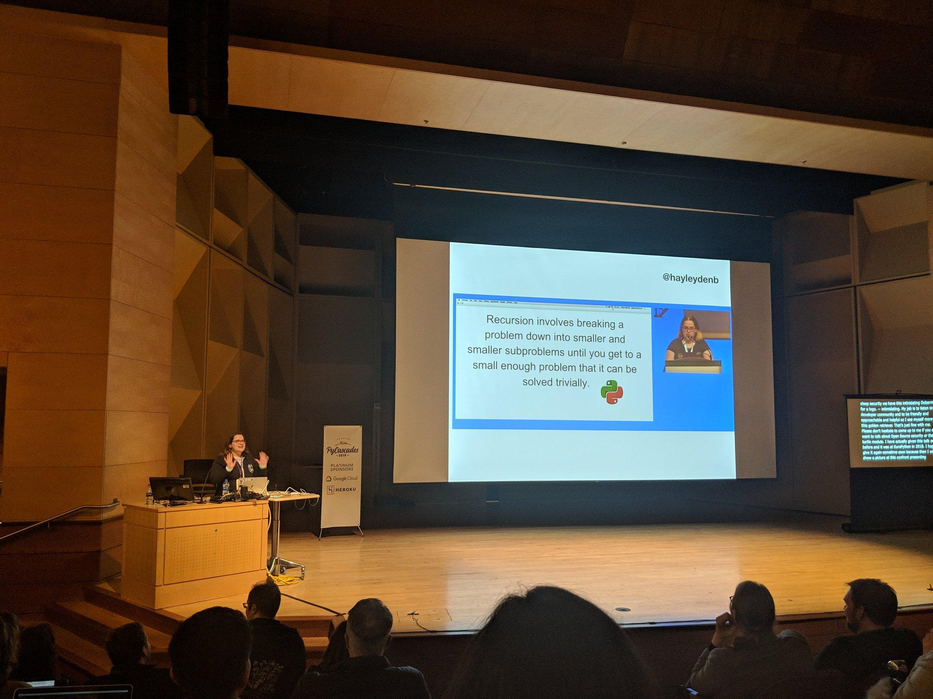

Hayley Denbraver
@hayleydenb

Slide 4
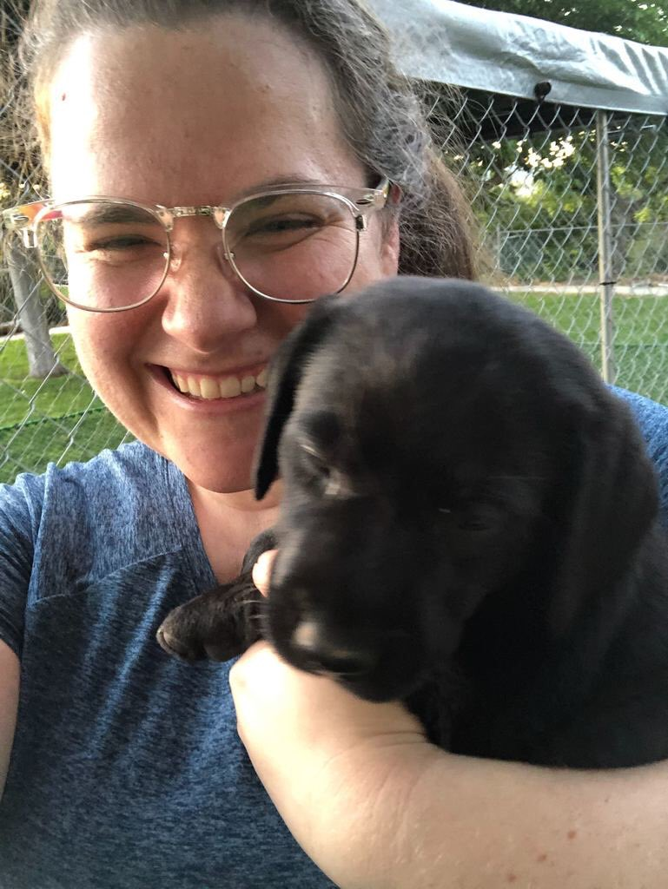
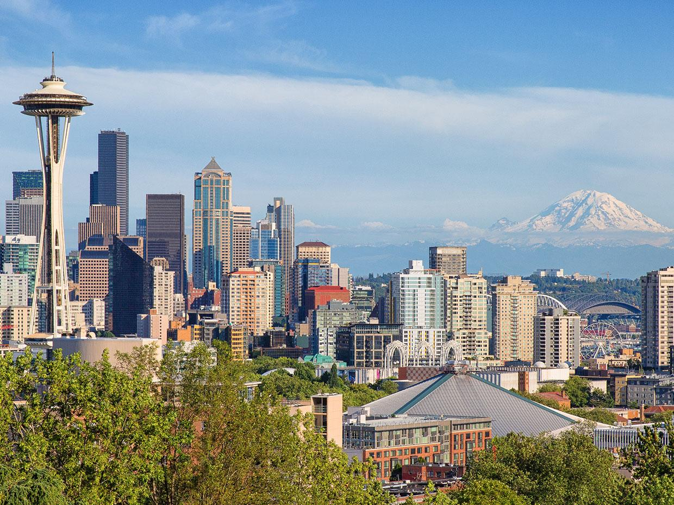
Hayley Denbraver
@hayleydenb

Slide 5
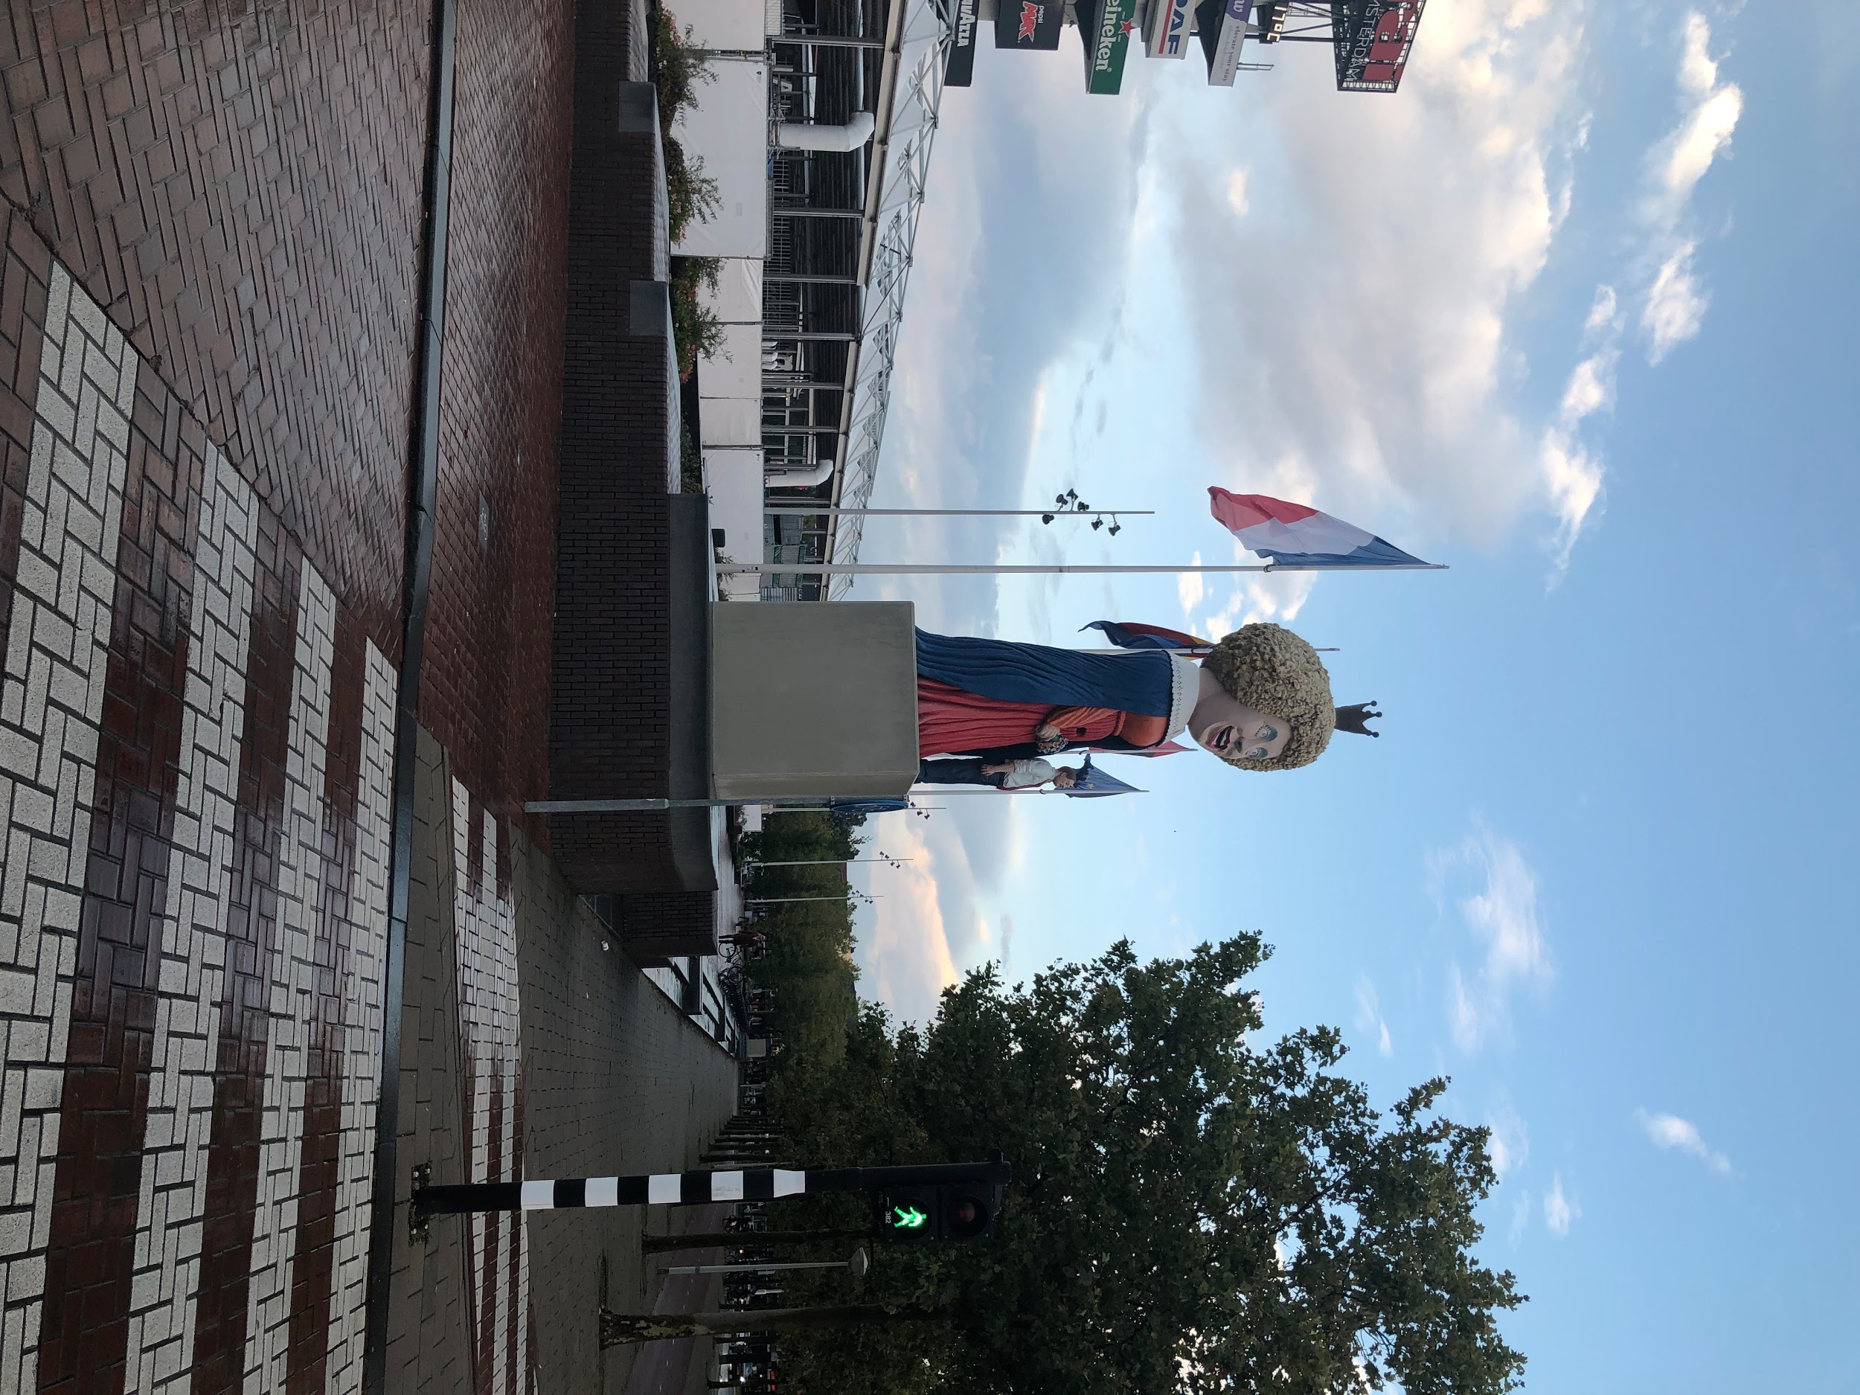
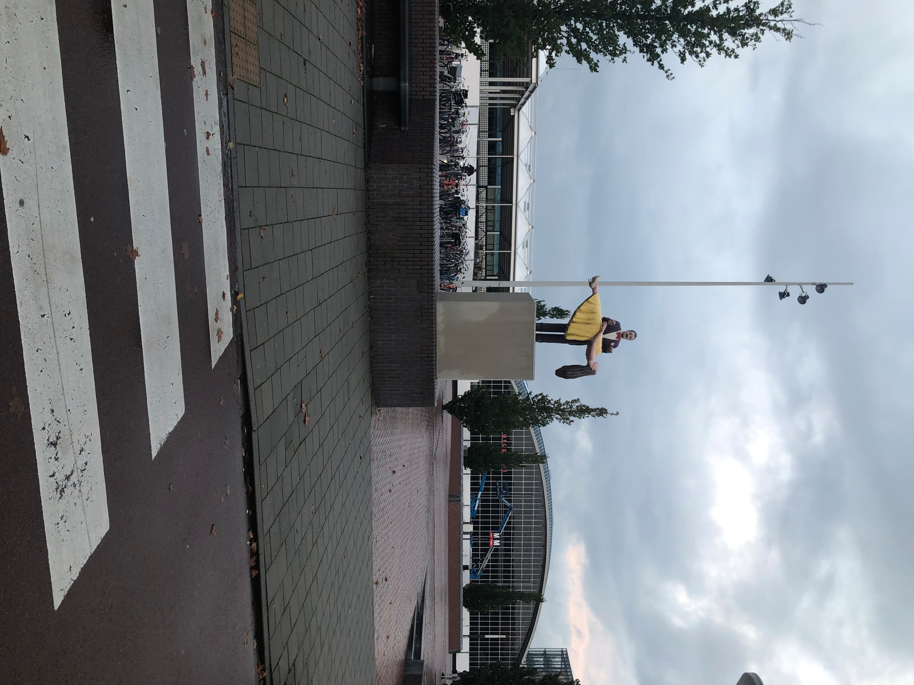

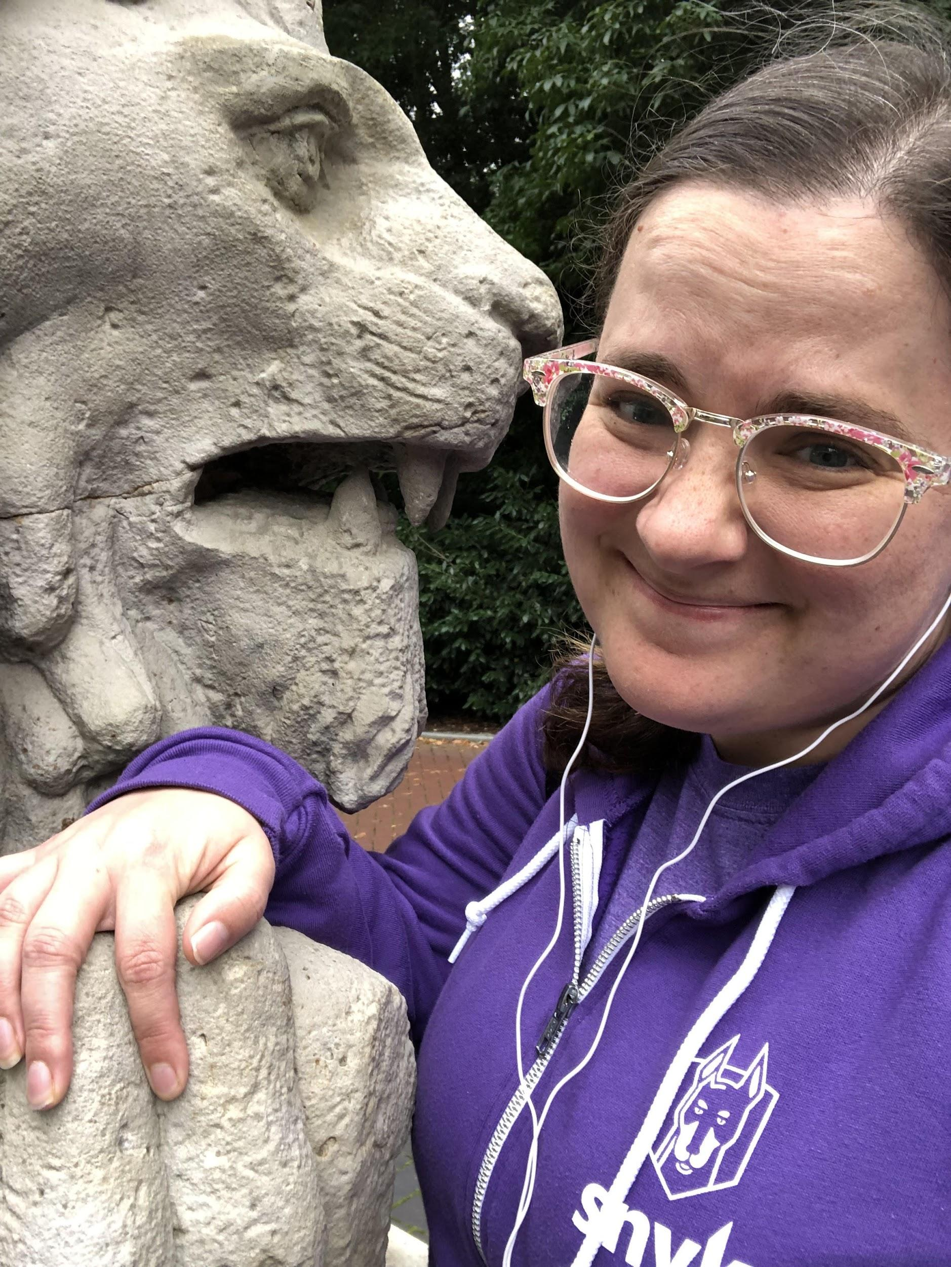
Hayley Denbraver
@hayleydenb

Slide 6

About this talk
Giphy original

Slide 7
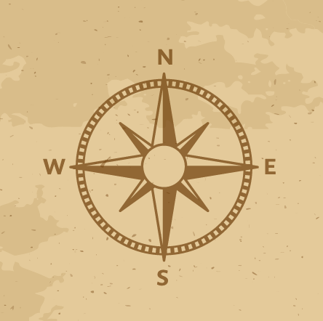
Our Map
CNCF + Security
Helm
Helm Chart Security
What does this Mean for Me?
Up your Security Game

Slide 8
CNCF + Security

Slide 9
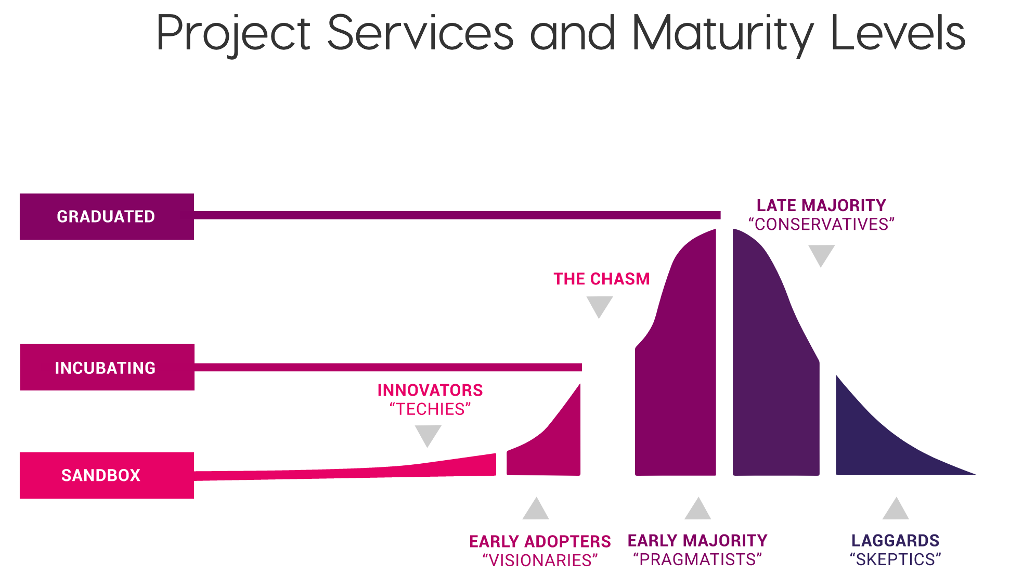

Slide 10


Slide 11
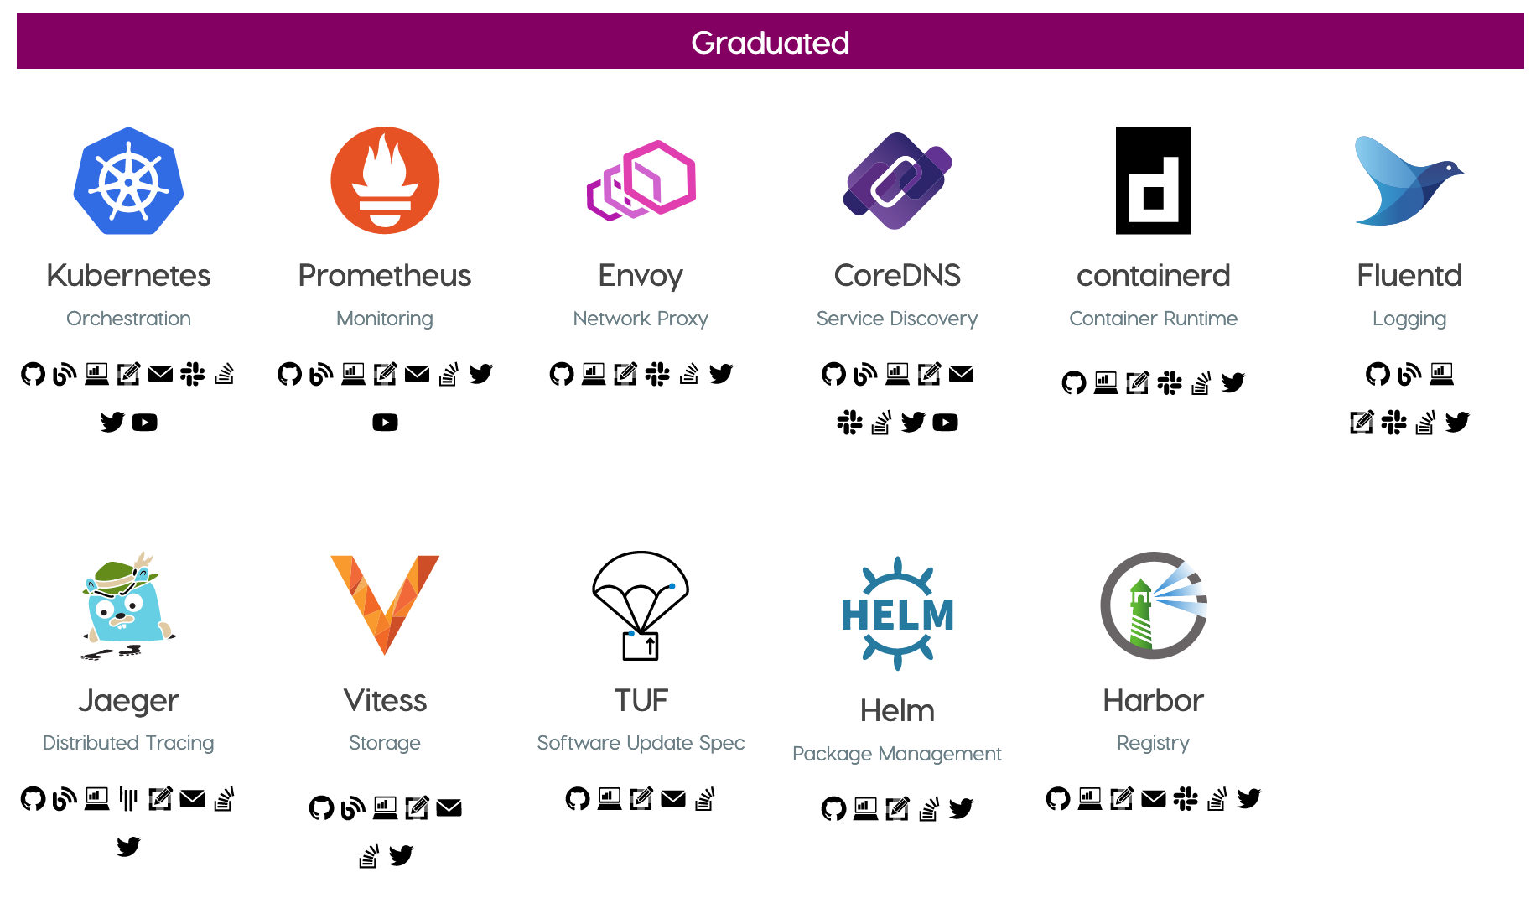

Slide 12
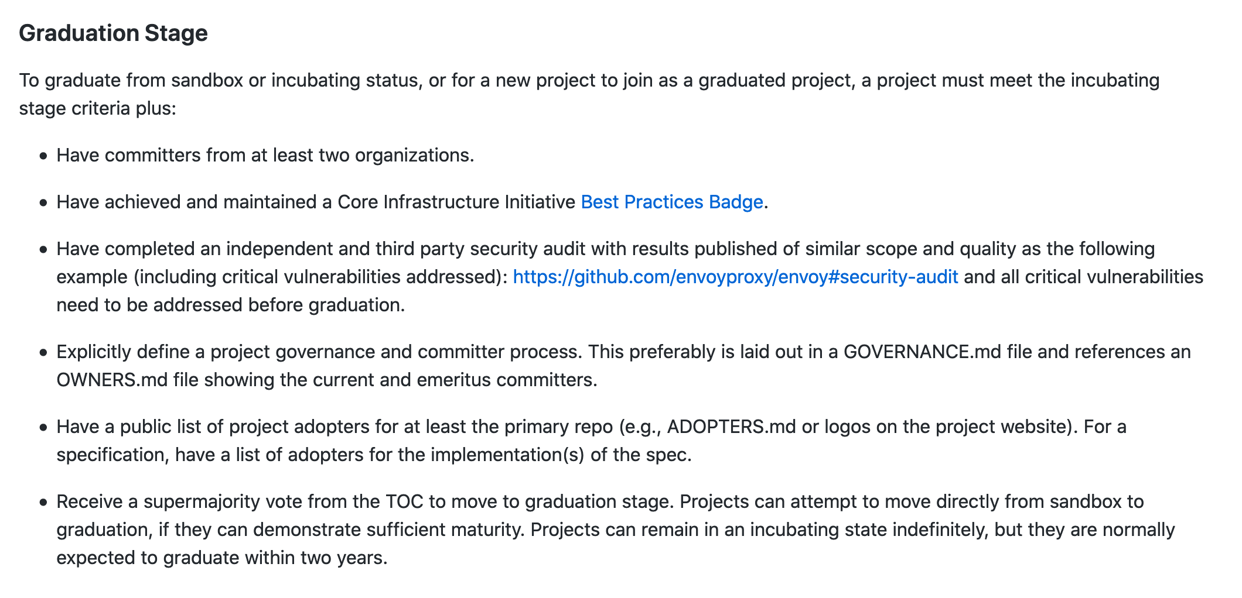

Slide 13
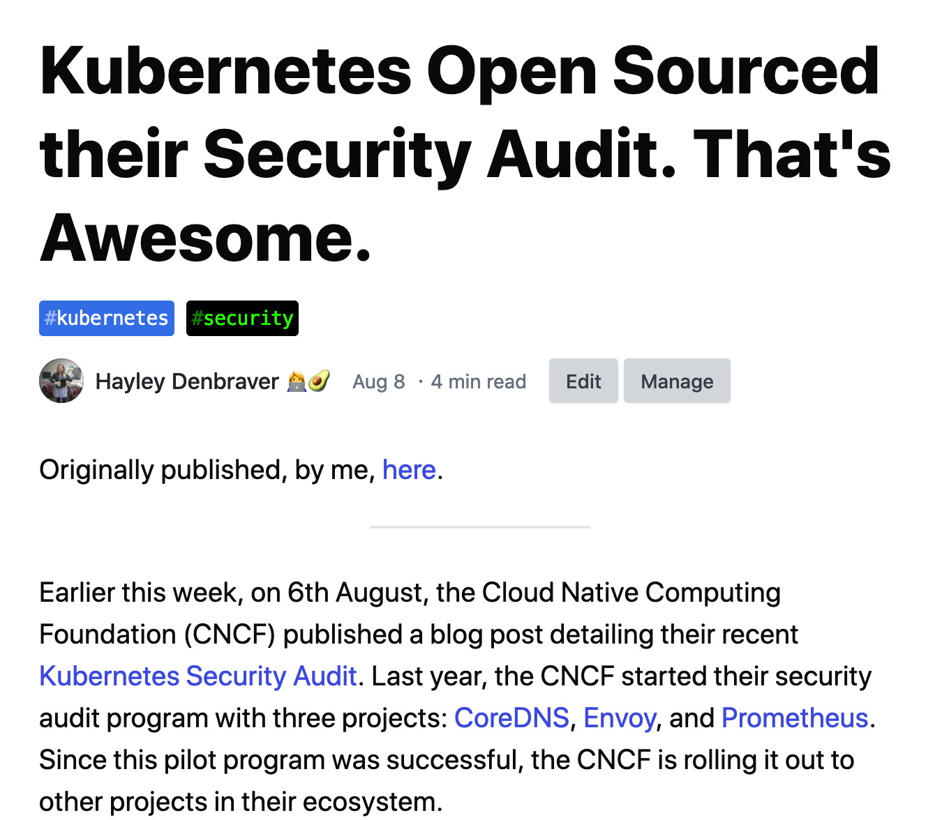

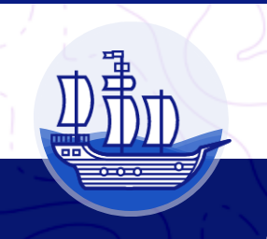

Slide 14
Helm

Slide 15
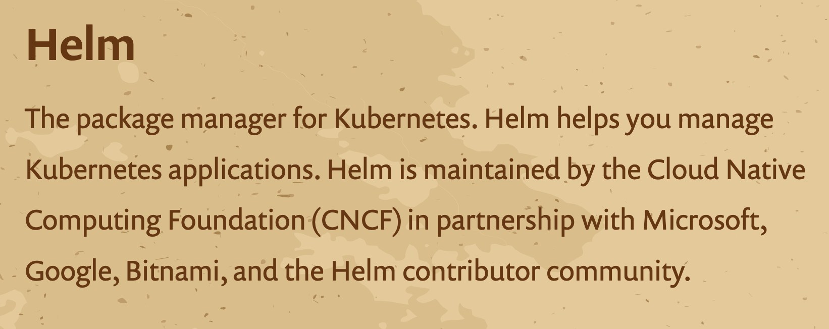

Slide 16
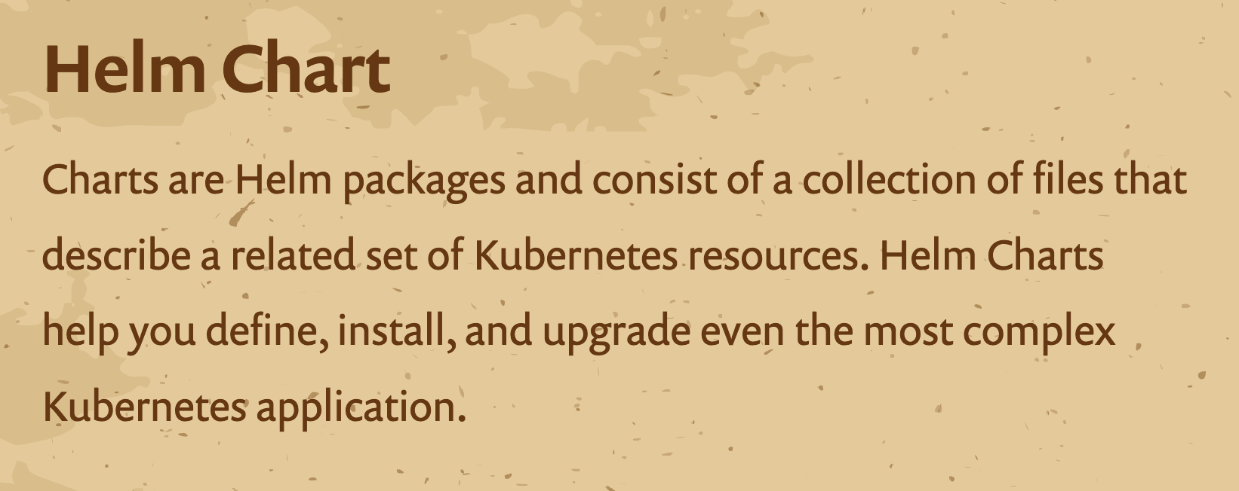

Slide 17
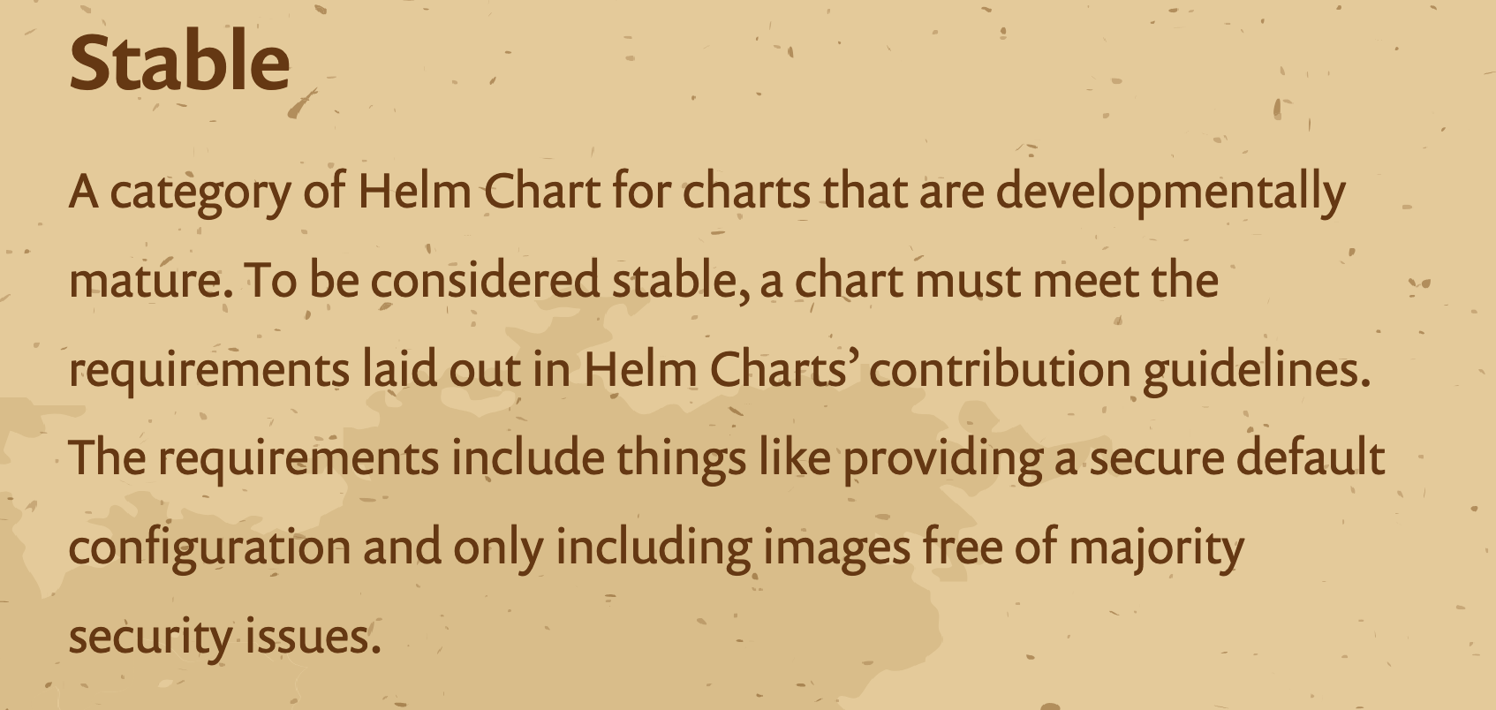

Slide 18
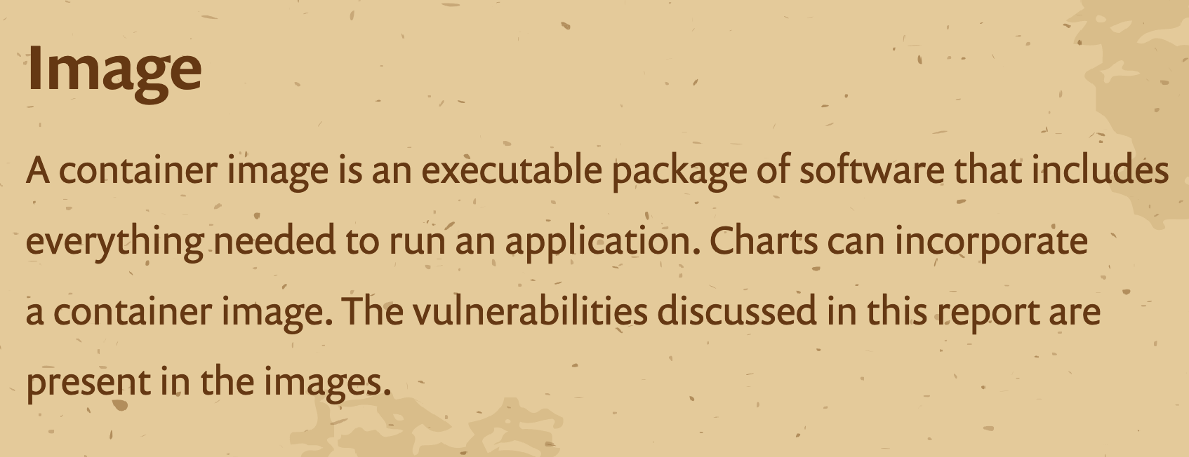

Slide 20
Charts

Slide 21
Charts
Images

Slide 22
Helm Chart Security

Slide 23
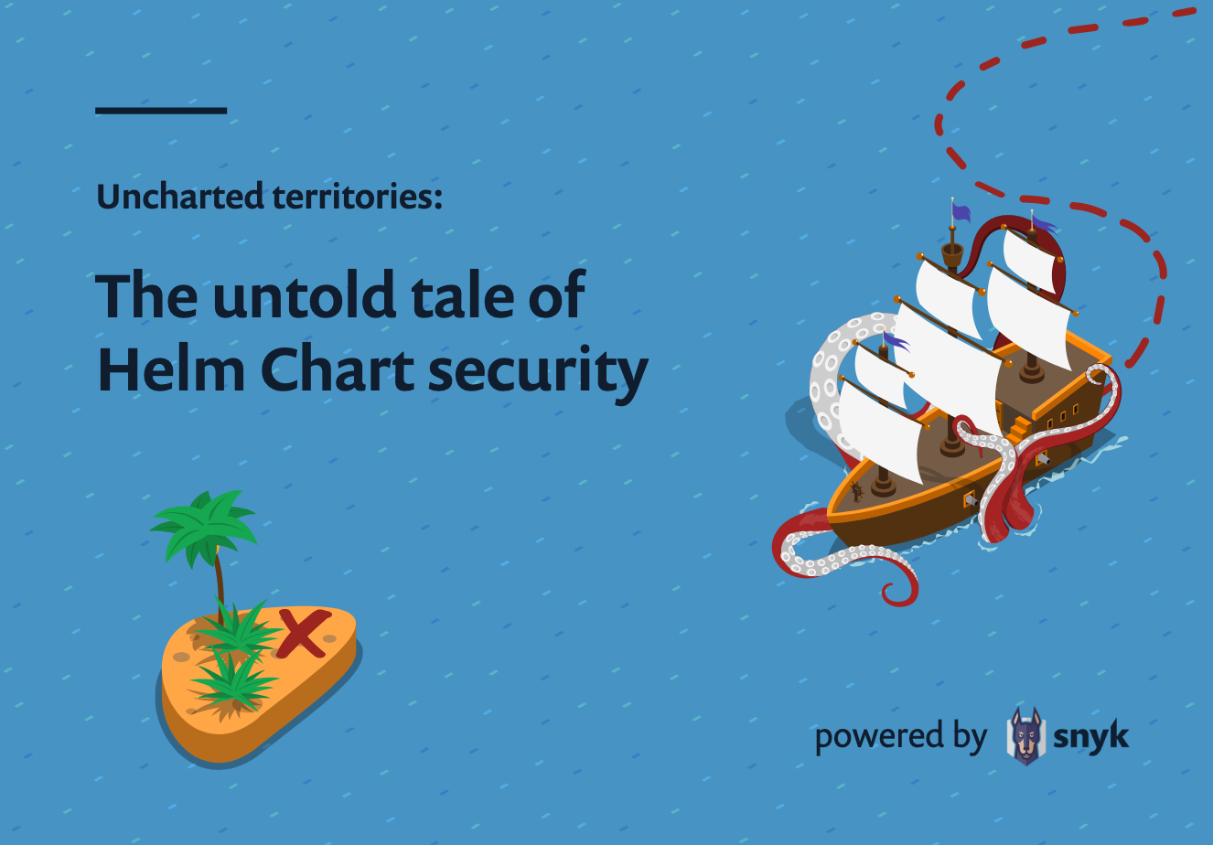

Slide 24
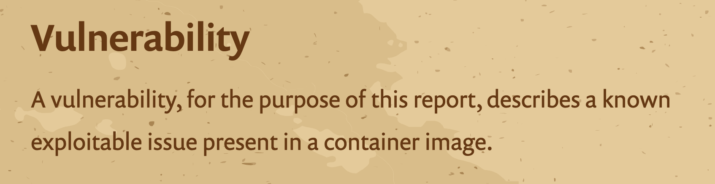

Slide 25
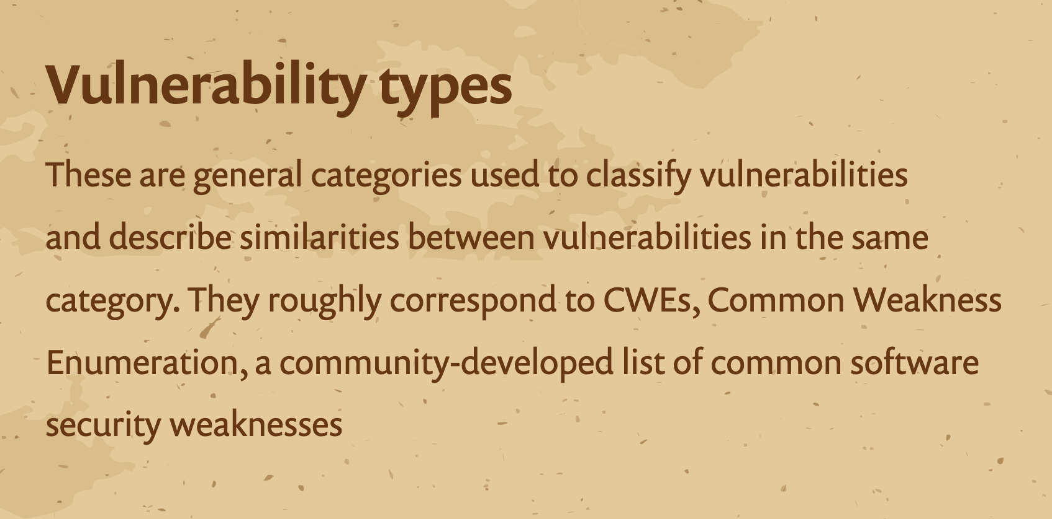

Slide 26
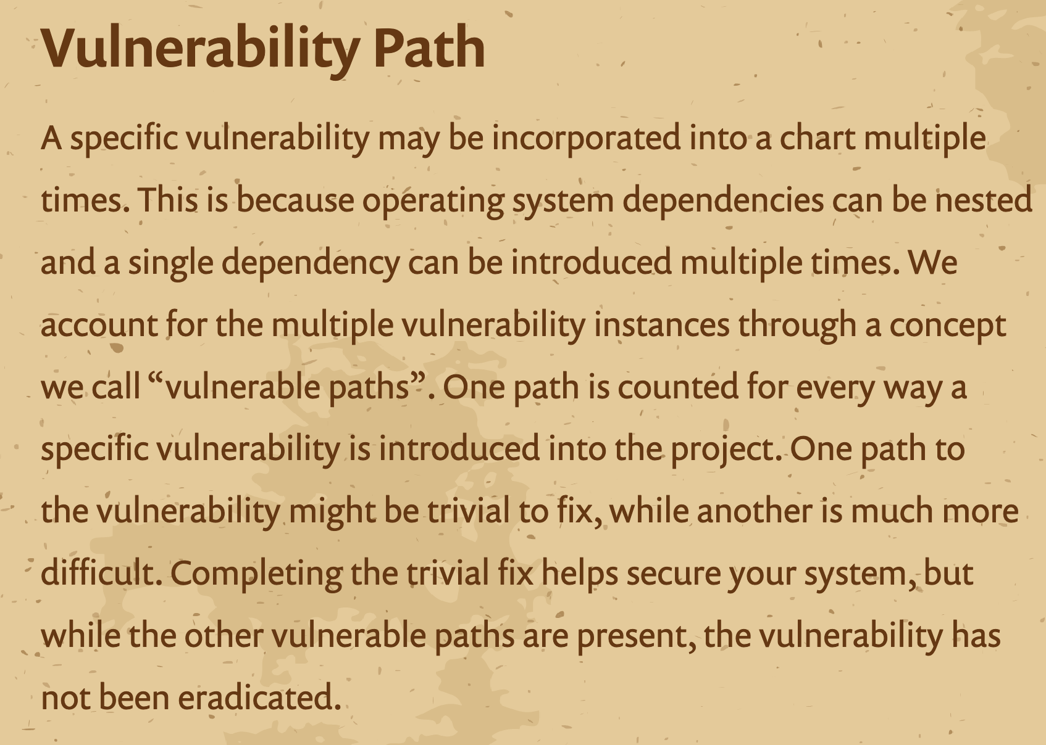

Slide 27
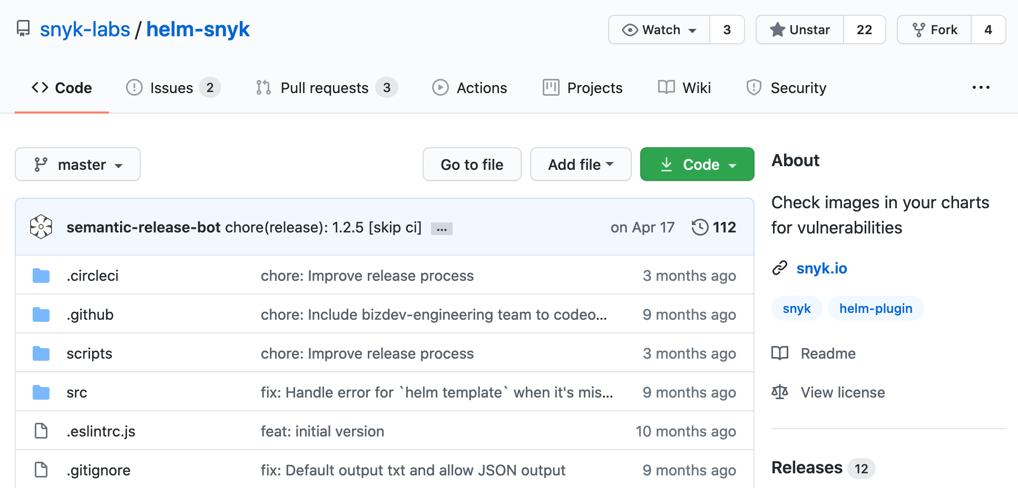

Slide 28
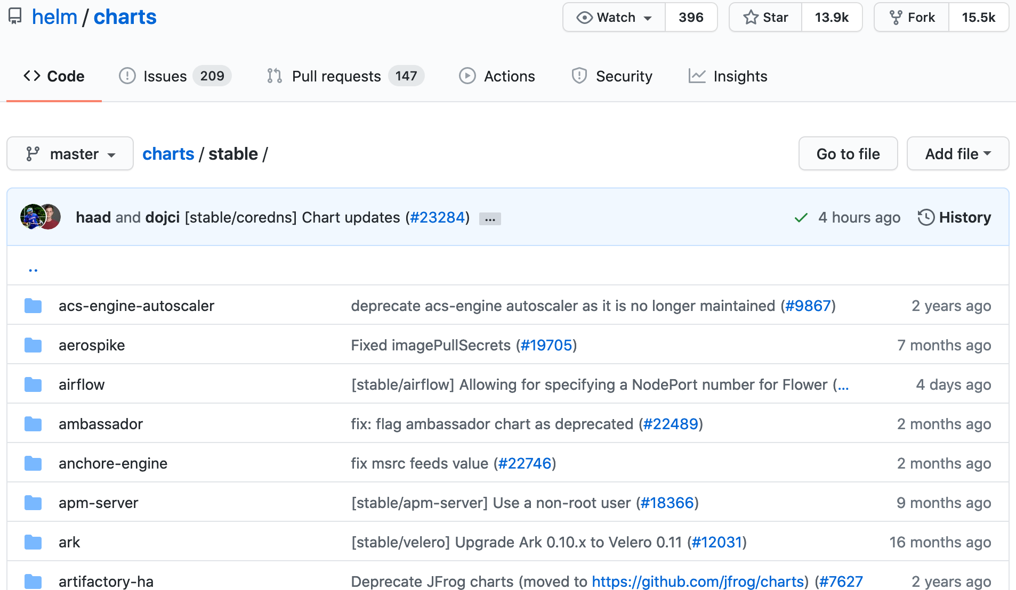

Slide 29
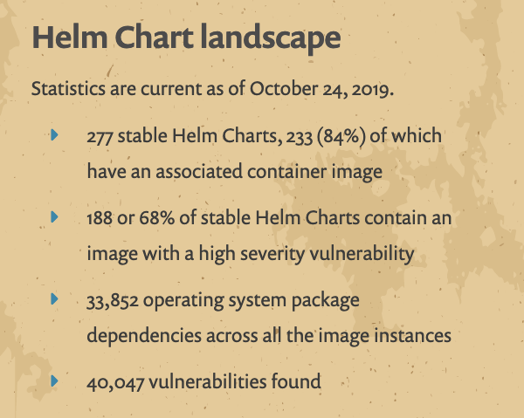

Slide 32
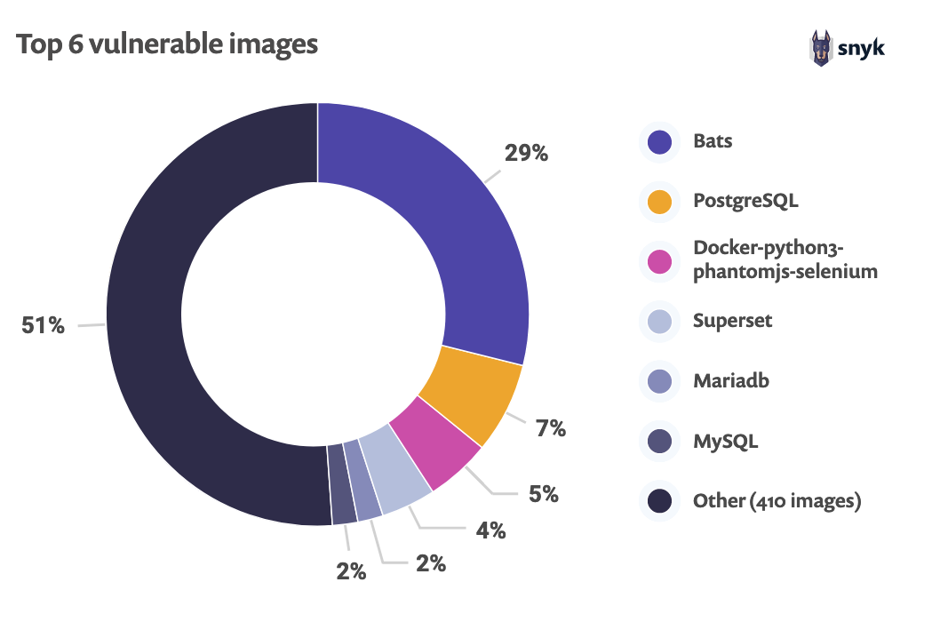

Slide 33
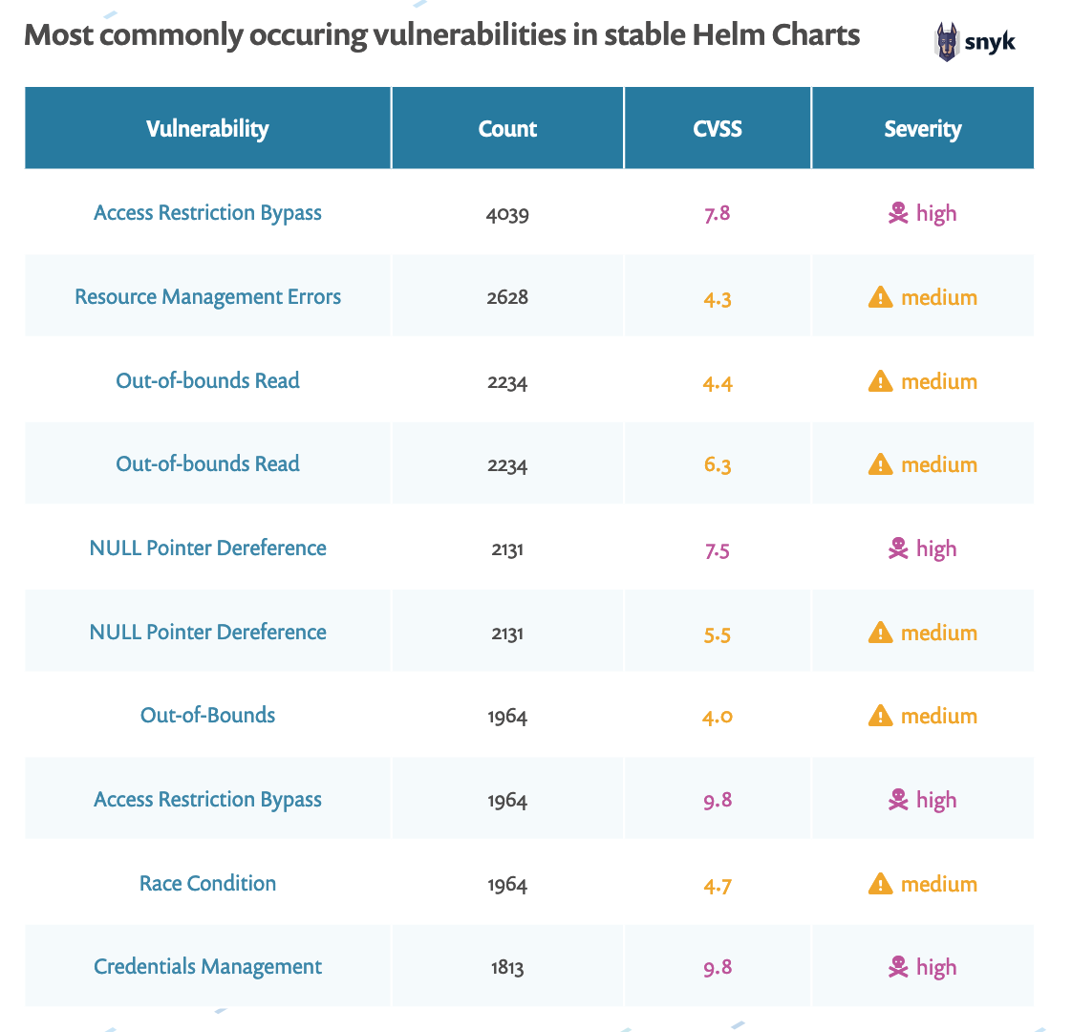

Slide 34
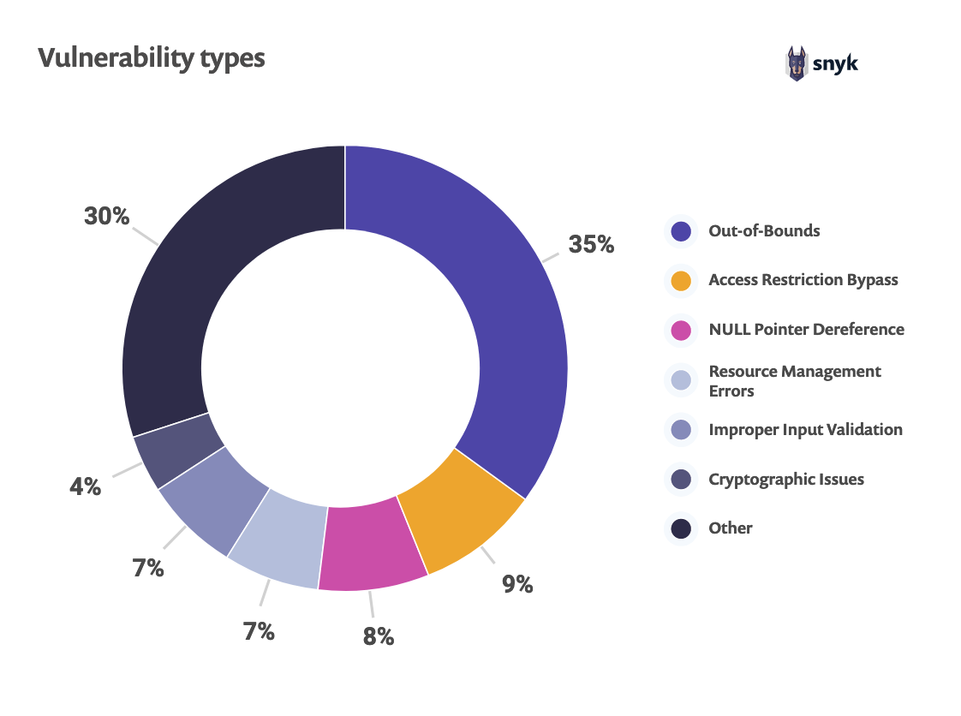

Slide 35
Out of Bounds

Slide 36
Access Restriction Bypass

Slide 37
NULL Pointer Dereference

Slide 38
What does this mean for me?

Slide 39
Remediation

Slide 40
Use Tools with Open Eyes

Slide 41
Consider All Vectors

Slide 42
Test Your Charts

Slide 43
Up your security game

Slide 44
Helm Best Practices

Slide 45
Migrate to Helm 3

Slide 46
Lose What you Don’t Use

Slide 47
Consider your Configuration

Slide 48
Thank you

Slide 49
Helm Maintainers

Slide 50
Sarah Conway, Gareth Rushgrove, Jeff McLean, Liran Tal

Slide 51
Growth Labs (@GrowthLabsMKTG)

Slide 52
Resources
Helm Chart Security Report
Helm Security Audit
Helm Security Assurance Case
Snyk’s Helm Plugin
Helm Best Practices

Slide 53
Hayley Denbraver
Software Engineer, Developer Advocate, Technical Content Creator
@hayleydenb
dev.to/hayleydenb

Slide 54
Questions?

